Slide 1

Tree Detection and Counting
An AI model that automatically detects trees in an image and counts the number of trees.

Slide 2
OBJECTIVE
Develop and fine‑tune a lightweight, real‑time object detection model to accurately identify individual trees in front‑view images of group of trees.
Automate tree counting by post‑processing the detected bounding‑box outputs to yield reliable per‑image tallies.

Slide 3
MODEL USED: YOLOv8
YOLO (You Only Look Once) is one of the most efficient real-time object detection models.
YOLOv8 can detect multiple instances of trees (like a forest or orchard) in a single forward pass, making it ideal for counting.
YOLOv8 is designed to balance high detection accuracy with low inference time.
Your task involves drawing bounding boxes around trees → YOLOv8 natively supports bounding box regression
Small Dataset Friendly (Transfer Learning): We can fine-tune a pre-trained model on a small custom dataset and still get reliable performance.

Slide 4
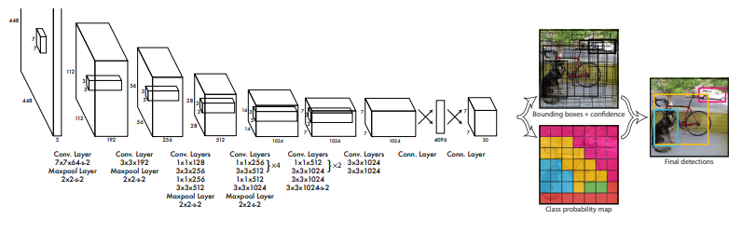
MODEL ARCHITECTURE

Slide 5
APPROACH 1
First approach was to use the available dataset of Trees.
A labelled data of trees prepared in a model feedable format (YOLO v8) is already available at Tree Yolo annotated.
The approach is to download the pre-trained YOLO v8 model and train it on the acquired dataset.
This should make YOLO v8 model identify tree in an image and count the number of identified trees.

Slide 6
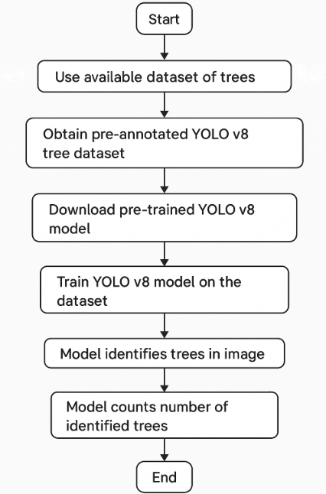

Slide 7
TRAINING
Epochs: 50
Image size: 640 pixels
Batch size: 8
Took 50 epochs at first because the dataset has 1k+ labelled images which is decent for training. BUT, considering that a new class has to be added to the pre-existing classes of the YOLO v8 model, the epochs must not be less than 30 for a dataset like this, otherwise the loss value will be high.

Slide 8
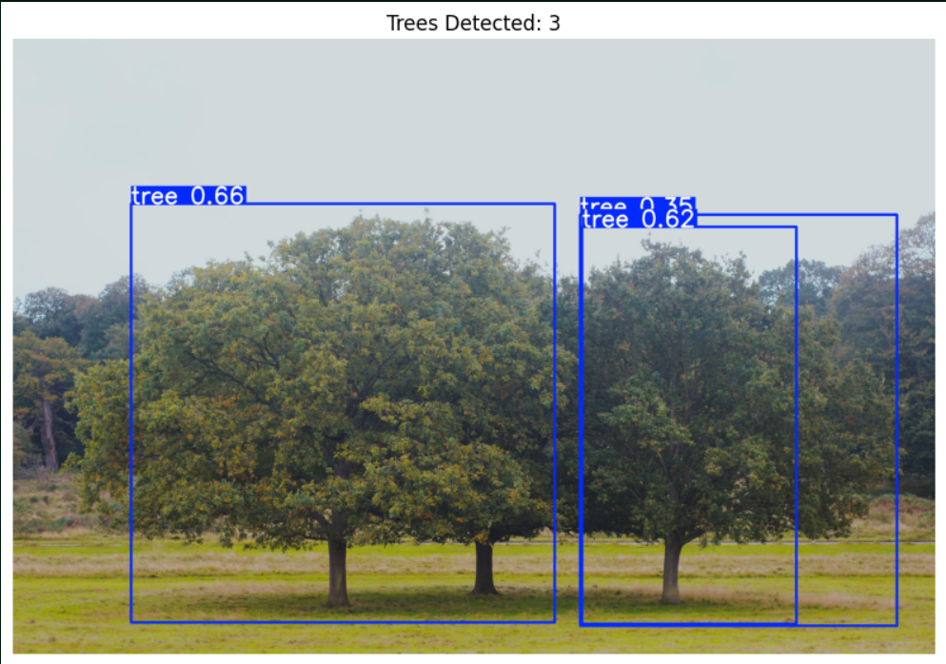
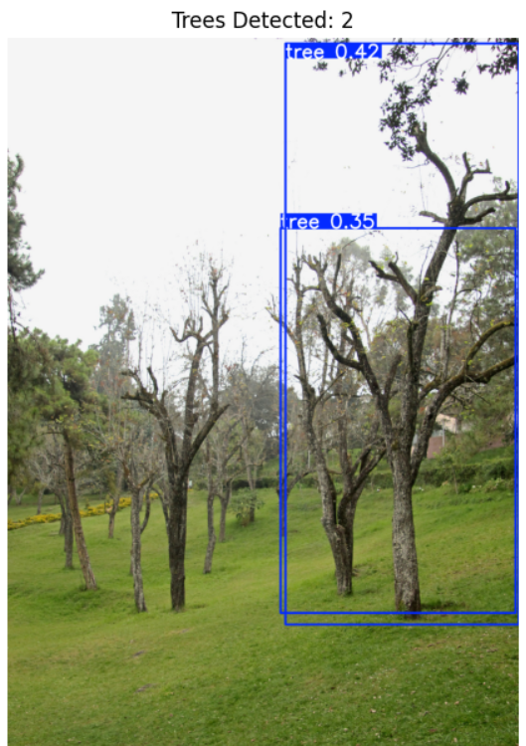
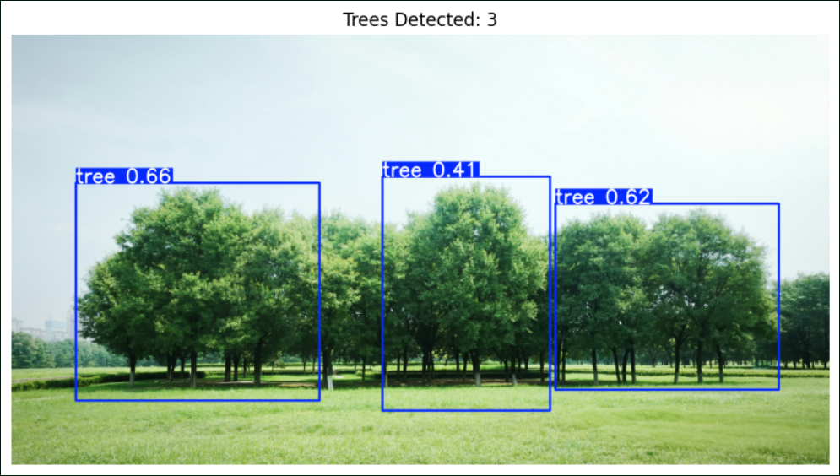
OUTPUT
The model could not identify separate trees in an image having multiple trees. Since the model is trained on a dataset having labels of the main Tree only. The model is unable to recognize separate surrounding trees.

Slide 9
LIMITATIONS
The data is labeled to identify the main Tree (Single).
Hence the model fails to recognize multiple trees in a multi-tree image.
The model is not trained on images with many trees.
The model does not consider the background trees.
It does not converge to the goal.

Slide 10
APPROACH 2
Since there is no data available of a group of trees(front view), first step to this approach would be to collect data from various sources like Trees photos.
After data is collected, the data needs to be prepared for feeding the model (Data Annotations). Herein the images are labeled with trees through bounding boxes around each tree in an image
After this, the YOLO v8 model is downloaded with it’s pretrained weights
Then the model is Trained to identify & count trees.

Slide 11
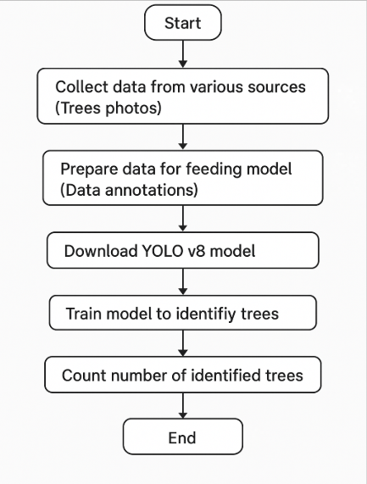

Slide 12
TRAINING
Epochs: 100
Image Size: 640 pixels
Batch Size: 16
Took 100 epochs in this approach. This is because the dataset has a smaller number of labelled images. The dataset has 113 images in total which is further divided into training and validation (8:2). And the number of bounding boxes is much more along with the number of trees hence there is a high risk of loss.

Slide 13
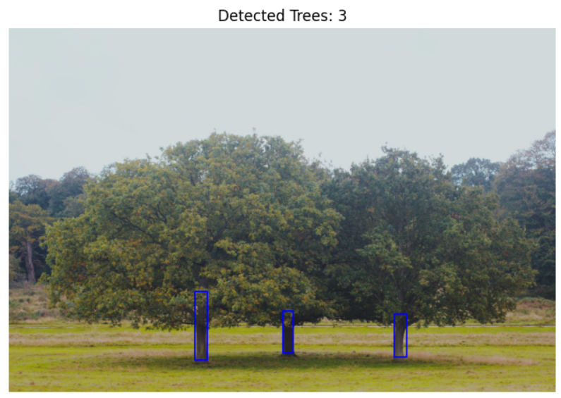
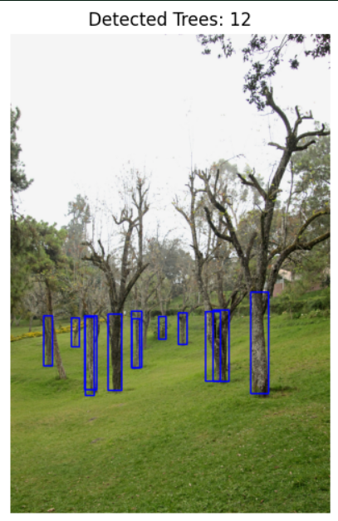
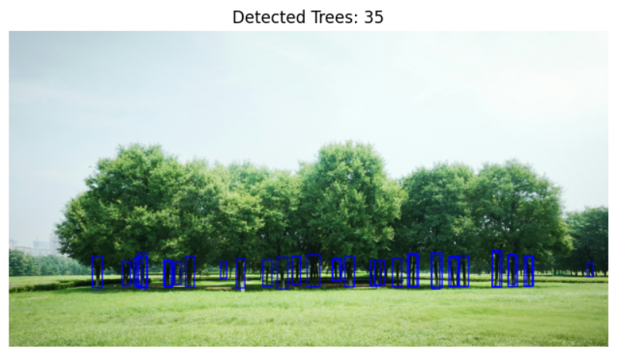
OUTPUT
The output using this approach is much accurate and the model can identify and count the number of trees in the image. The model is now able to identify approximately every tree in an image.

Slide 14
LIMITATIONS
Data availability: There is no dataset available as of now which has group of trees in images.
Data preparation: Data preparation is also one of the challenge in this approach as a large amount of data is to be labelled precisely with trees through bounding boxes.
Data preparation as of now would take approximately one day to label 50 images, for a single person.
Accuracy: There is a lack in accuracy because of shortage of data.

Slide 15
IMPROVEMENTS TO BE MADE
To continue Approach 2, there’s a need of more data.
Hence, more data is to be acquired first.
Then the acquired data needs to be labelled precisely considering the barks of all the trees in an image.
There is an option to try a heavier version of YOLO v8 model trained on an extended dataset, named as YOLOv8m-oiv7 which will require a stronger GPU of minimum 16GB VRAM.
Furthermore, tuning of hypermeters would be done post training.

Slide 16
CHALLENGES
Data Availability: Desired data is not available, i.e, the data required to train the model is not available on the web.
Accuracy Evaluation: There’s a problem in evaluating accuracy of the model. For example, if there are 8 trees in an image, and the model can identify 7 of them, the evaluation matrices would still consider this whole as a True Negative, which will result in wrong evaluation.

